Slide 1
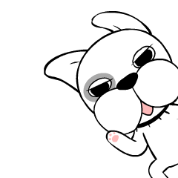

Slide 2
Classroom English

Slide 3
Raise your hands.

Slide 4
Put your hands down.

Slide 5
Take out your book.

Slide 6
Put away your book.

Slide 7
Open your book.

Slide 8
Close your book.

Slide 9
Come here, please.

Slide 10
Go back to your seat.

Slide 11
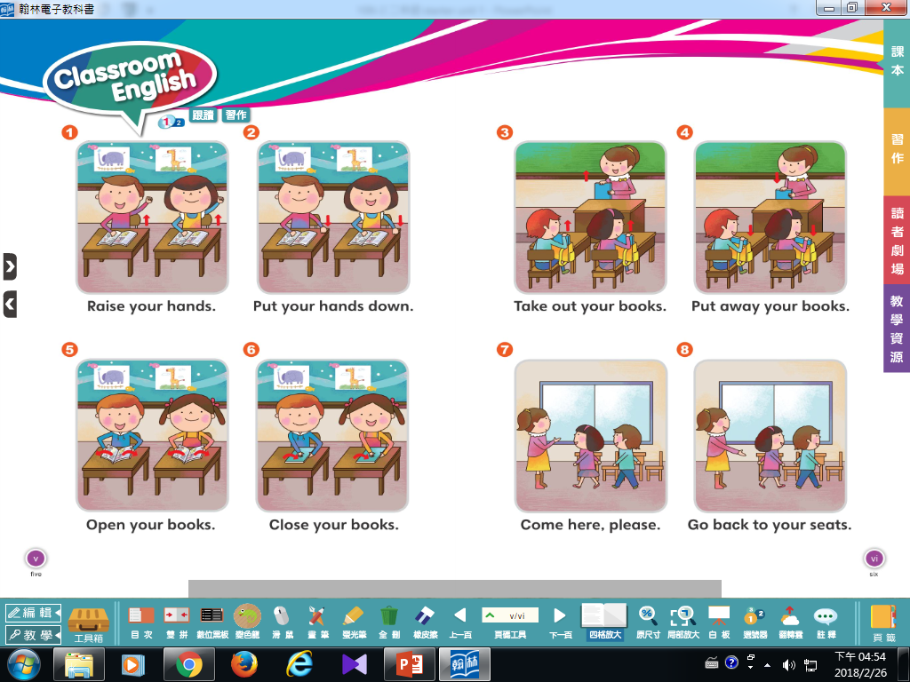

Slide 12
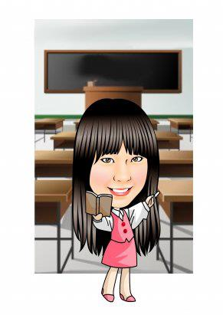
Look and guess.
Mandy says.
Whispering.

Slide 14
A~Z connection

Slide 16
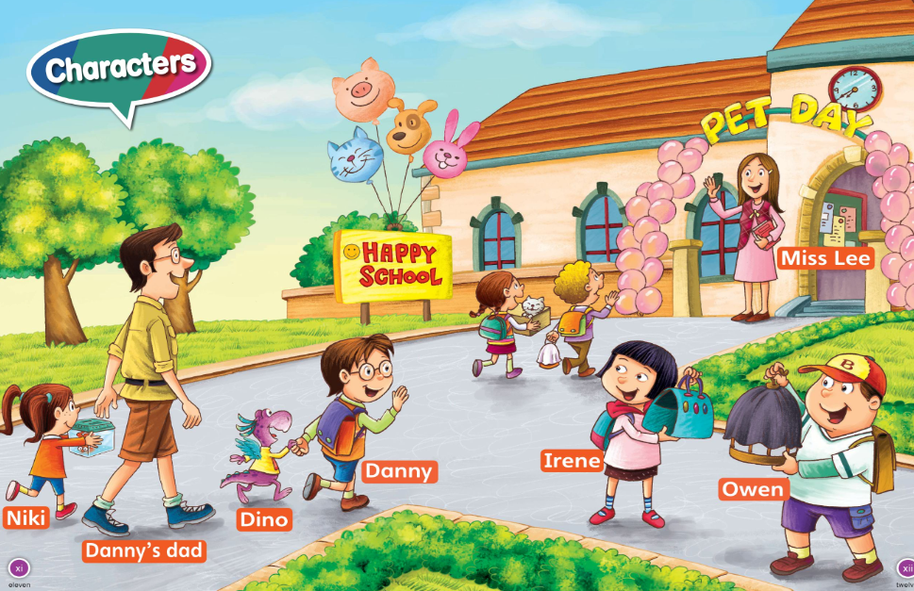

Slide 17
We are pets.

